Slide 1
Project Cost Management
PMI Knowledge Areas

Slide 2
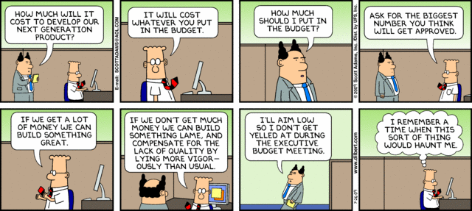
The Importance of Project Cost Management
IT projects have a poor track record for meeting budget goals
A 2011 Harvard Business Review study reported an average cost overrun of 27 percent. The most important finding was the discovery of a large number of gigantic overages or “black swans”

Slide 3
Examples of how not to mange costs
The U.S. government (e.g. IRS)
The United Kingdom’s National Health Service IT
http://www.bbc.co.uk/news/uk-15014288
http://www.bbc.co.uk/news/uk-politics-24130684
http://www.hsj.co.uk/news/technology/rising-cost-of-nhs-it-fiasco/5063357.article#.UlbD8NKsh8E

Slide 4
What is Cost and Project Cost Management?
Cost is a resource sacrificed or foregone to achieve a specific objective or something given up in exchange
Project cost management includes the processes required to ensure that the project is completed within an approved budget

Slide 5
Project Cost Management Processes
Scope Baseline
Schedule Baseline
Estimate bases
Project Funding Req.
Estimate Costs
Determine Budget
Control Costs
Activity Cost Estimates
Cost Baseline

Slide 6
Project Cost Management Processes
Process Group | Cost Management Process | Major Output
Planning | CP1: Planning Cost Mgmt | Cost Management Plan
 | CP2: Estimating Costs | Activity Cost Estimates
 | CP3: Determining the Budget | Cost Performance Baseline
Monitoring and Controlling | MC1: Controlling Costs | Work Perf. Measurements Budget Forecasts

Slide 7
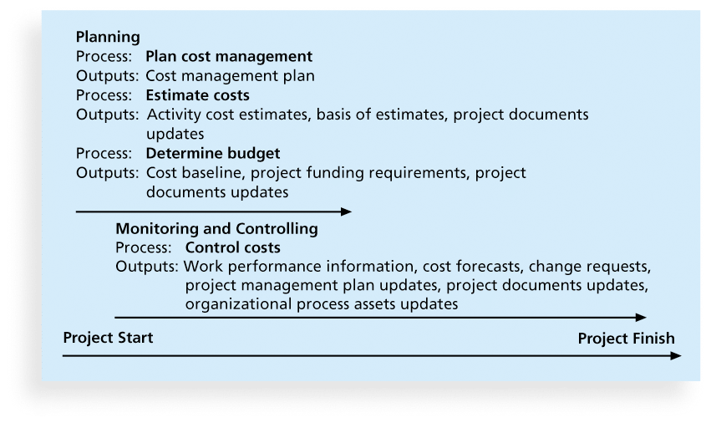
Figure 7-1. Project Cost Management Summary

Slide 8
Basic Principles of Cost Management
Most members of an executive board better understand and are more interested in financial terms than IT terms , so IT project managers must speak their language
Profits
Profit margin
Life cycle costing
Cash flow analysis

Slide 9
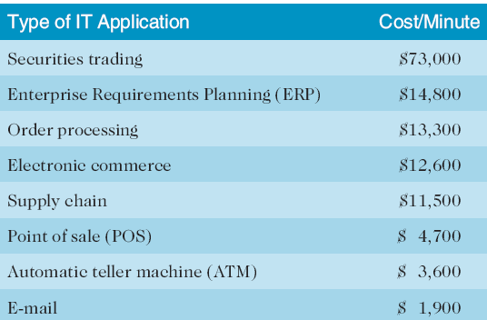
Cost of Downtime for IT Applications
Source: The Standish Group International, “Trends in IT Value,” www.standishgroup.com (2008).

Slide 10
MC1: Controlling Costs
Project cost control includes
Monitoring cost performance
Ensuring that only appropriate project changes are included in a revised cost baseline
Informing project stakeholders of authorized changes to the project that will affect costs
Many organizations around the globe have problems with cost control
Work Performance Measurement helps

Slide 11
Performance Measurement Analysis
Earned Value Management
Given a baseline (original plan plus approved changes), you can determine how well the project is meeting its goals
You must enter actual information periodically to use EVM
Based on:
Planned value (PV)
Actual cost (AC)
Earned value (EV)

Slide 12
Rate of Performance
Rate of performance (RP)
Ratio of actual work completed to the percentage of work planned to have been completed
For example, suppose the server installation was halfway completed by the end of week 1. The rate of performance would be 50% because by the end of week 1, the planned schedule reflects that the task should be 100 percent complete and only 50 percent of that work has been completed

Slide 13
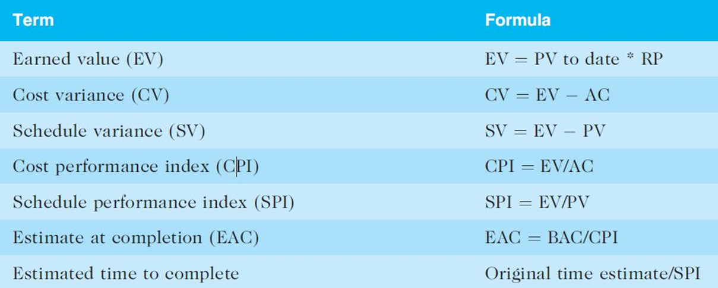
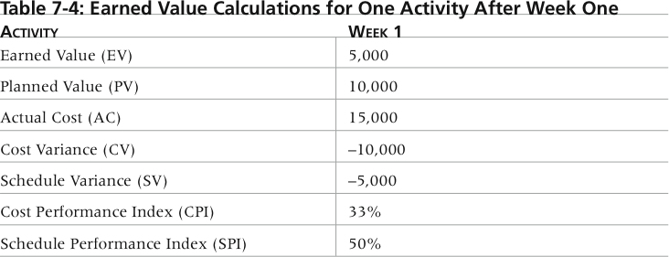
Earned Value Calculations for One Activity After Week One

Slide 14
Rules of Thumb for EV Numbers
Negative numbers for cost and schedule variance indicate problems in those areas
CPI and SPI less than 100% indicate problems
Problems mean the project is costing more than planned (over budget) or taking longer than planned (behind schedule)
The CPI can be used to calculate the estimate at completion (EAC)—an estimate of what it will cost to complete the project based on performance to date. The budget at completion (BAC) is the original total budget for the project

Slide 15
Example
You are a PM constructing a 16-mile road
Completion time: 12 weeks
Approved budget (BAC): $600,000
At the end of 4 weeks, $125,000 has been spent and 4 miles of road is complete.

Slide 16
Example – Work Performed
Budgeted Cost of Work Performed
Calculate if we are on budget
Earned Value
Cost Variance
Cost Performance Index
Estimate at Completion – estimate at the current point in time for how much it will cost to complete the project

Slide 17
Example – Work Scheduled
Budgeted Cost for the Work Scheduled
Calculate by schedule
Planned Value
Schedule Variance
Schedule Performance Index
Estimated time to complete – estimate based on schedule thus far to complete project

Slide 18
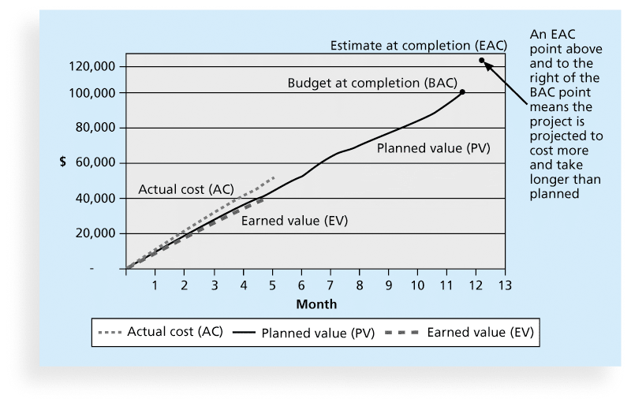
Earned Value Chart for Project after Five Months

Slide 19
Global Issues
EVM is used worldwide, and it is particularly popular in the Middle East, South Asia, Canada, and Europe
Most countries require EVM for large defense or government projects, as shown in Figure 7-6
EVM is also used in such private-industry sectors as IT, construction, energy, and manufacturing.
However, most private companies have not yet applied EVM to their projects because management does not require it, feeling it is too complex and not cost effective

Slide 20
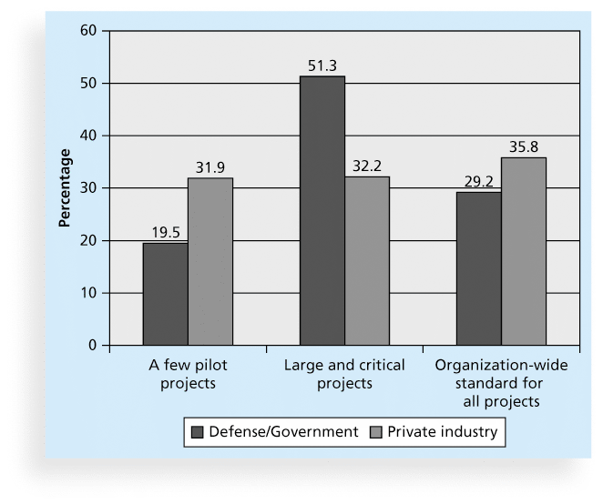
Figure 7-6. Earned Value Usage

Slide 21
Project Portfolio Management
Many organizations collect and control an entire suite of projects or investments as one set of interrelated activities in a portfolio
Five levels for project portfolio management
Put all your projects in one database
Prioritize the projects in your database
Divide your projects into two or three budgets based on type of investment
Automate the repository
Apply modern portfolio theory, including risk-return tools that map project risk on a curve

Slide 22
Benefits of Portfolio Management
Schlumberger saved $3 million in one year by organizing 120 information technology projects into a portfolio
ROI of implementing portfolio management software by IT departments:
6.5% average annual savings in IT budget (end year 1)
Improved annual avg project timeliness by 45.2%
Reduced IT management time spent on status reporting by 43% and IT labor capitalization reporting by 55%
Decreased the time to achieve financial sign-off for new IT projects by 20.4%, or 8.4 days

Slide 23
Best Practice
A global survey released by Borland Software in 2006 suggests that many organizations are still at a low-level of maturity in terms of how they define project goals, allocate resources, and measure overall success of their information technology portfolios. Some of the findings include the following:
Only 22 percent of survey respondents reported that their organization either effectively or very effectively uses a project plan for managing projects
Only 17 percent have either rigorous or very rigorous processes for project plans, which include developing a baseline and estimating schedule, cost, and business impact of projects
Only 20 percent agreed their organizations monitor portfolio progress and coordinate across inter-dependent projects

Slide 24
Sample Cost Estimate
Run a cost estimate for the Recreation and Wellness Intranet Project.

